Slide 1

Programming One & Two (csc7050) (csc7051)
Aidan McGowan

Slide 2
P1 Exam structure
3 hours
40% Weight in module
1 – 20 short multi choice / single word or phrase response questions
1 – [20 Marks] UML diagram - Create class…

Slide 3

Question Mark exams
Ensure you can login …
ads\student_number etc

Slide 4
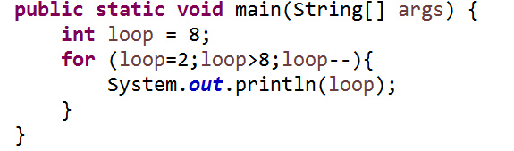
Multiple choice example
a. 2 3 4 5 6 7 8
b. An exception would be thrown at runtime.
c. Loop runs to out of bounds
d. nothing
e. 2 3 4 5 6 7
Notes:
Ans : D

Slide 5
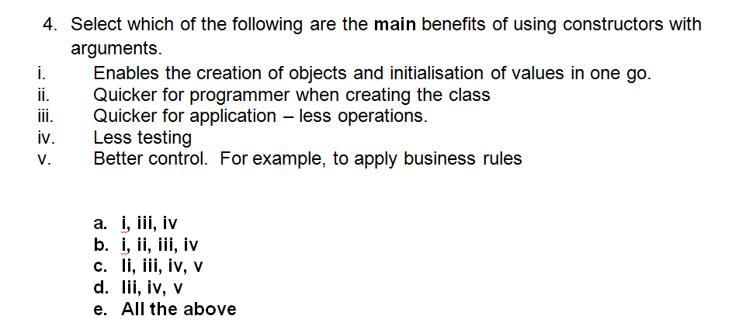
Multiple choice example
Notes:
Ans : E

Slide 6
Complete the code example
Person
title : String firstName: String lastName : String recentConcussion : Boolean
+ displayAll()
<interface> F1License
+ driveSuperCar()
Create the F1Driver class.
The drive method should output “Driving road car”.
The driveSuperCar should output “Driving F1 Car”
In addition if the recentConcussion is true than the driveSuperCar should return “Unfit to drive F1 Car”
F1Driver
+ drive()
Notes:
Create the F1 class (implement the interface and extend from the Abstract class)
Constructor with arguments – include validation / apply business rules if required….?
Include Getters and Setters – business rules / validation
Implement the drive() method
Implement the method from the Interface driveSuperCar() – apply business rule

Slide 7
P2 Exam structure
3 hours
30% Weight in module
14 multi choice short, answer questions
1 – (Open response question)[16 Marks] Main method with instructional comments. Given the expected output of the method. Complete the code.

Slide 8
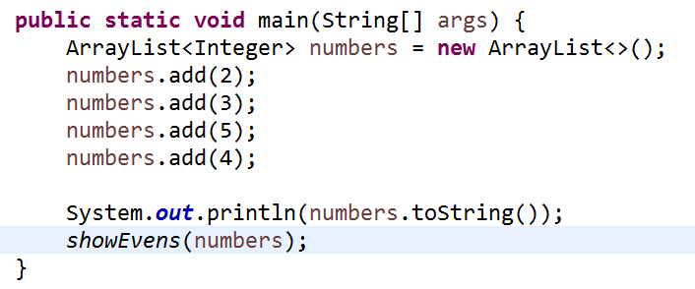
Write the method …
Notes:
public static void showEvens(List<Integer> numbers){
for (Integer i : numbers){
if (i%2==0){
System.out.println(i);
}
}
}

Slide 9
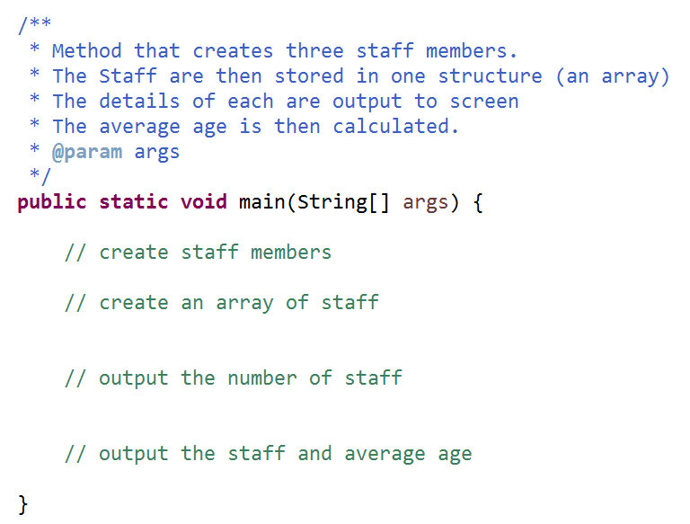
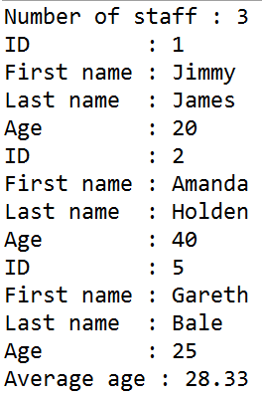
Main method with instructional comments
Staff class – already created to be used in the following main method. The showAll method displays to screen all the details of the Staff member
Staff
ID : int firstName : String lastName : String age : int
+ showAll()

Slide 10
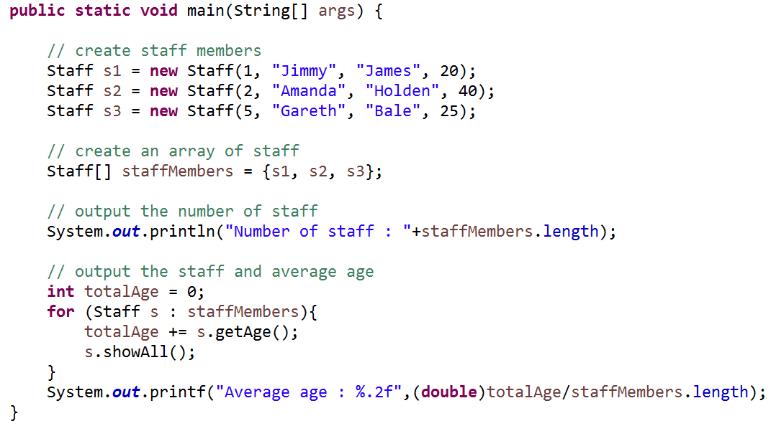
Main method with instructional comments - answer

